Slide 1

The Inspector General Assistance Function
“We’re here to help.”
Part One

Slide 2
Administrative Notes
  Inspection ground rules apply
  Be on time
  Use table mics & have name tents visible
  Avoid sidebar conversations
  Do not surf the web or check email
  I may defer questions – topics build
  I want to hear from you, but please do NOT use names of units, individuals, etc.
Student Course Evaluations

Slide 3
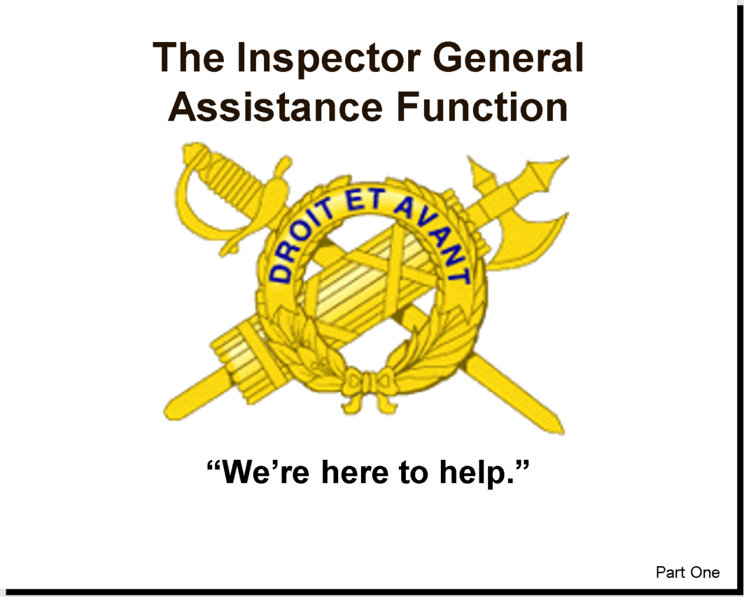
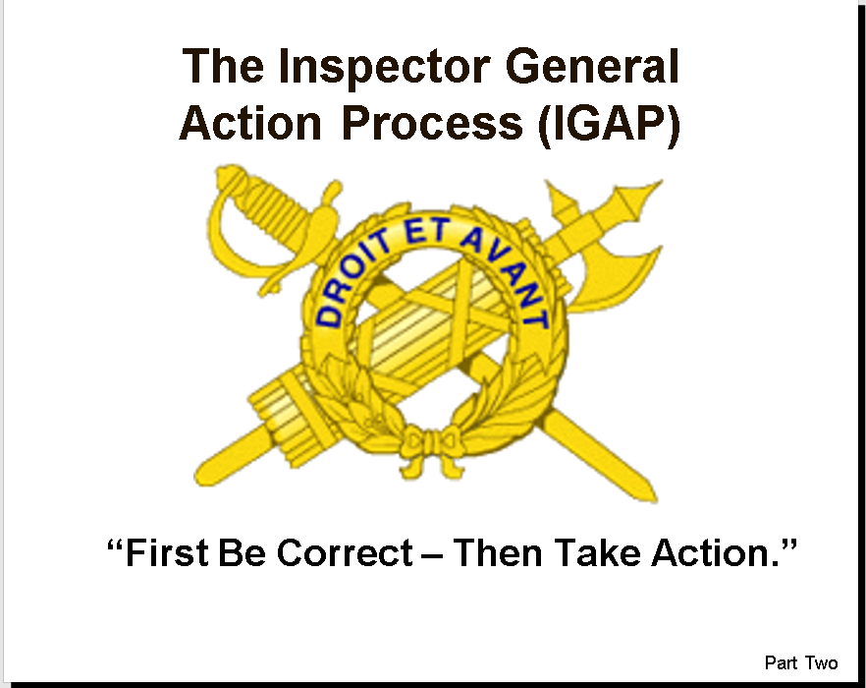
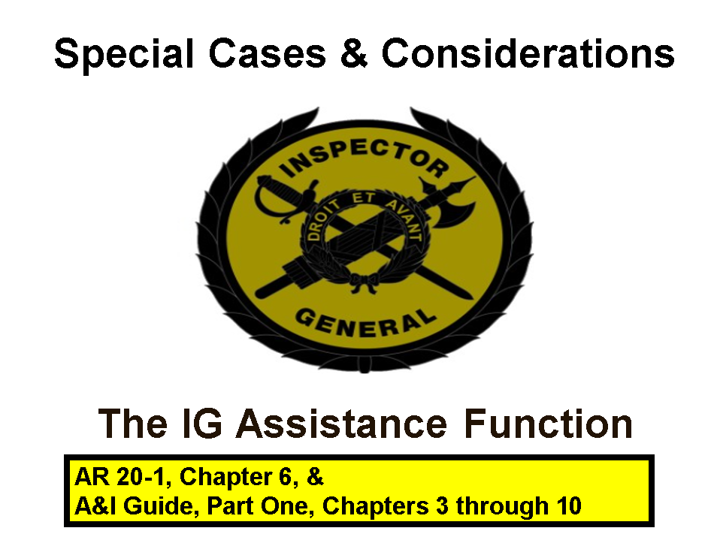
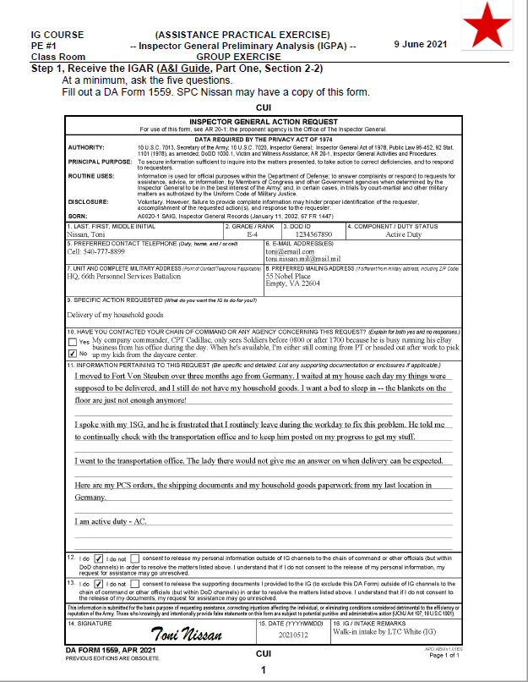
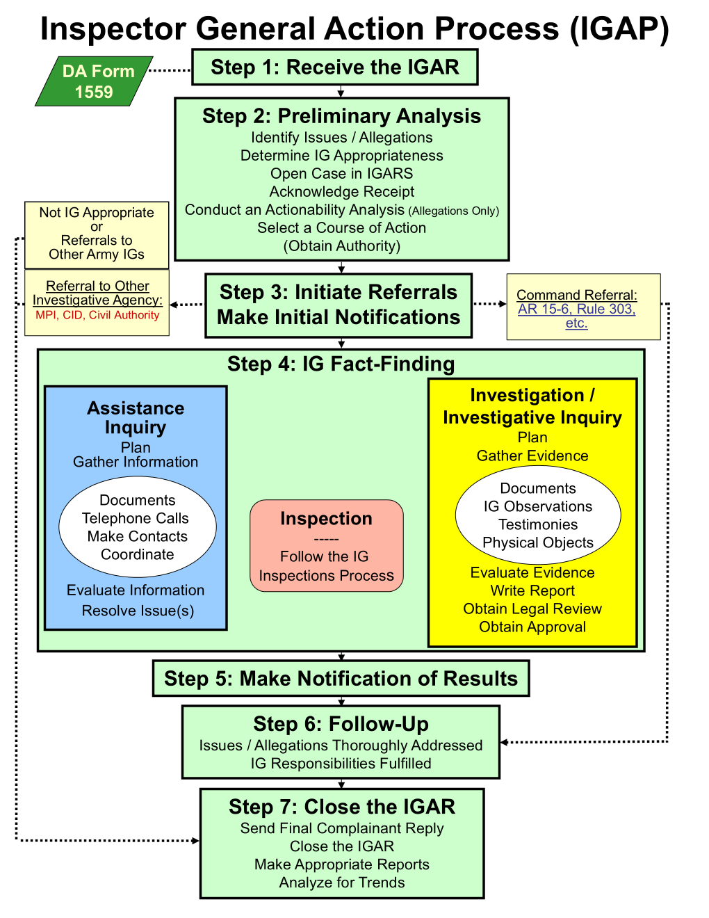
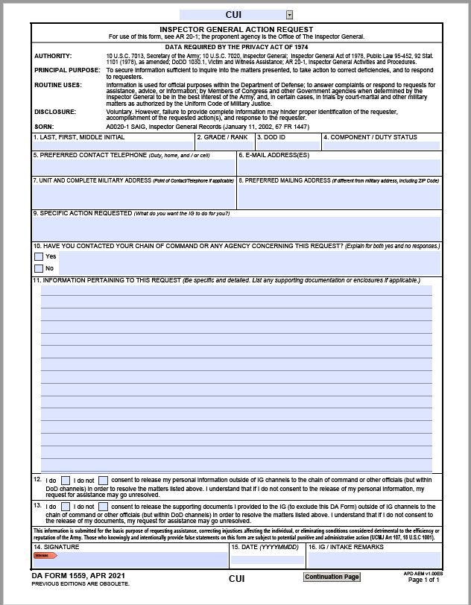
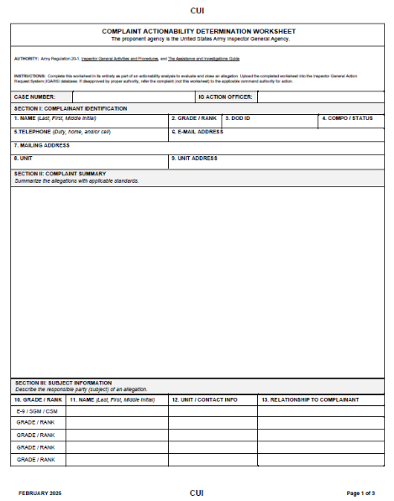
Assistance Materials
3

Slide 4
A Few Key Acronyms
  Inspector General Action Process
  (IGAP)
  Inspector General Action Request
  (IGAR)
  Inspector General Action Request System
  (IGARS)
  Inspector General Preliminary Analysis
  (IGPA)
  Actionability Analysis Determination Process
  (AADP)

Slide 5
References
Advance Sheets, pages 17-18
The Assistance and Investigations Guide
AR 20-1, Inspector General Activities and Procedures
AR 600-20, Army Command Policy
AR 608-99, Family Support, Child Custody, and Parentage

Slide 6
Terminal Learning Objective
Action: Resolve complaints and issues for an individual using the Inspector General Action Process (IGAP).
Conditions: Given Army Regulation 20-1, The Assistance and Investigations Guide, classroom handouts, classroom instruction, and Inspector General Action Request (IGAR) topics.
Standard: Correctly apply the seven-step Inspector General Action Process (IGAP) to resolve Inspector General Action Requests (IGARs), describe the Inspector General (IG) concept of confidentiality, and describe the policy guidelines regarding IG Records.

Slide 7
Knowledge ELOs
ELO
Identify who may submit an Inspector General (IG) complaint.
Describe the purpose and uses of the DA Form 1559, Inspector General Action Request (IGAR).
Describe the seven-step Inspector General Action Process (IGAP) used to receive, process, and resolve IGARs.
Describe the IG concept of confidentiality and the authorizations needed from the complainant to release that person's personal information for the purpose of resolving the individual’s issue or to inform a third party.

Slide 8
Knowledge ELOs
ELO
Identify issues and allegations that are not appropriate for the IG and describe how the IG must process those IGARs.
Describe the actions an IG should take upon receiving an allegation against a senior official.
Describe the commander’s role in receiving and resolving non-support cases in accordance with Army Regulation (AR) 608-99.
Describe the IG’s role in receiving and resolving non-support cases in accordance with AR 20-1.
Describe the actions an IG should take when a complainant withdraws a complaint.

Slide 9
Knowledge ELOs
ELO
Describe what constitutes an untimely IGAR and the procedures for processing an untimely IGAR.
Identify what records a local IG may release, to whom, and for what purpose.
Identify who is authorized to release IG records for adverse action.
Identify who is authorized to release IG records outside of DA channels for non-official use and how to process a Freedom of Information Act (FOIA) request.

Slide 10
Application ELOs
ELO
14. Demonstrate the process of receiving an IGAR by conducting an interview, completing a DA Form 1559 (IGAR), asking the fundamental interview questions, advising the complainant of the Privacy Act, and protecting confidentiality.
15. Determine the actionability of an allegation.
16. Demonstrate the process of opening and closing an Assistance case in the Inspector General Action Request System (IGARS) database.

Slide 11
Safety and Environmental
Safety Requirements: No other specific safety requirements are unique to this block of instruction per DA PAM 385-30, Risk Management, dated 2 December 2014.
Risk Assessment Level: Low in accordance with TRADOC Regulation 385-2, U.S. Army Training and Doctrine Command Safety and Occupational Health Program, dated 14 June 2024.
Environmental Considerations: None in accordance with AR 200-1, Environmental Protection and Enhancement, dated 13 December 2007, and ATP 3-34.5, Environmental Considerations, dated January 2024.

Slide 12
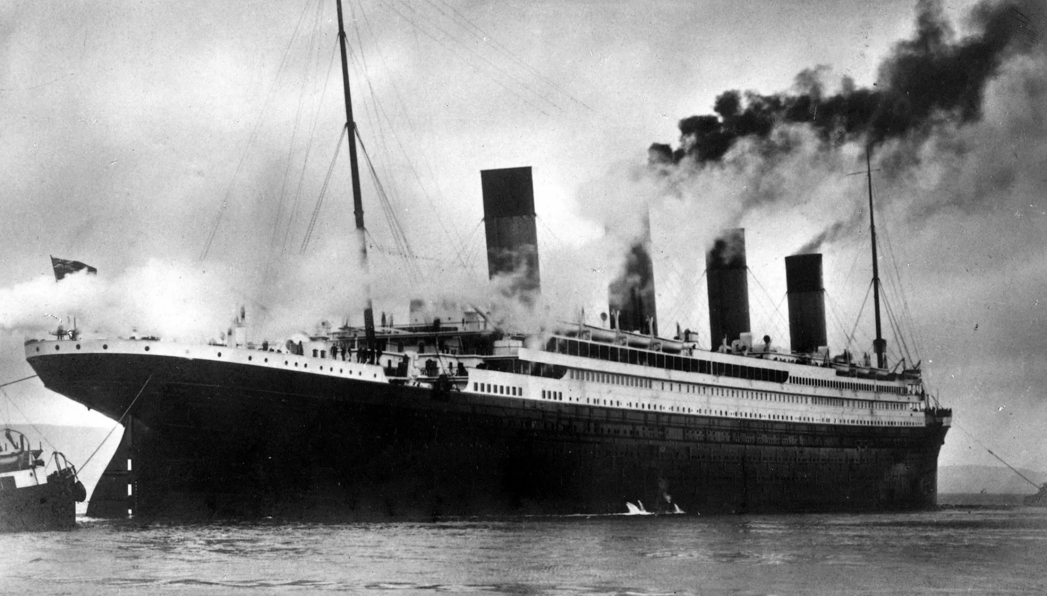
Issue #2:
Iceberg warnings went unheeded
Issue #3:
Binoculars locked away
Issue #1:
Weather conditions
Issue #4:
Speed – moving too fast!
Issue #7:
Lack of lifeboats
Issue #6
Material Failure
Issue #5:
Radio operator “off duty”

Slide 13
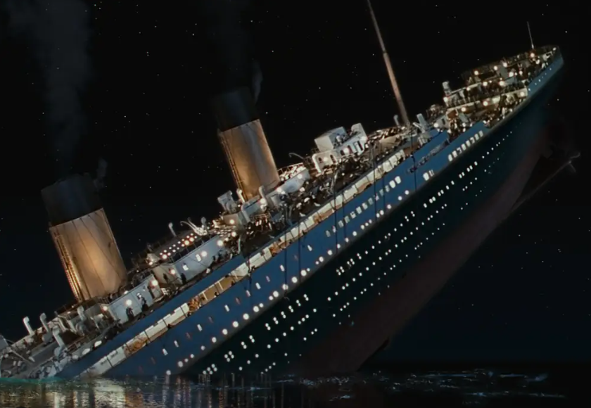
“They Said it Couldn’t Sink”
Succession of small Issues… led to BIG problems
- 2,200 Passengers
- 700 Survivors

Slide 14
Why?

Slide 15
Inspectors General Categories and Duties
Category of IG | Inspection | Assistance | Investigation
IG | Lead | Lead | Lead
Assistant IG | Lead | Lead | Assist
Temporary Assistant | Assist | Assist | Assist
Acting IG | No | Assist with supervision | No
Admin Support | No* | No* | No*
* Unless approved & graduate of TIGS
AR 20-1, para. 2-2

Slide 16
“Other” IG Categories
Unwilling or Unable
Don’t do their jobs correctly (Slept through IG course)
Take sides during an inquiry
Fail to assist complainants
Don’t take care of the commander, the Soldiers, the chain of command, or the Army
Decertified
Pretended to be commanders / 1SGs / CSMs
Released IG records without authority
Non-IG related improprieties

Slide 17
“The day Soldiers stop bringing you their problems is the day you have stopped leading them. They have either lost confidence that you can help them or concluded that you do not care. Either case is a failure of leadership.”
General Colin Powell

Slide 18



“What is your perception of the Inspector General?”
What we need everyone to know about the
Inspector General
What Soldiers think about the Inspector General
What leaders think about the
Inspector General

Slide 19
The Assistance Function
Render assistance
Correct injustices (real or perceived)
Help Commanders correct injustices and be proactive
Eliminate conditions detrimental to the efficiency or reputation of the Army
Use Tech Channels
Record and analyze data for corrective action
Provide the Soldier with an alternative to the chain of command when the chain of command is unable to solve the problem
Enhance combat readiness and warfighting capability by maintaining the Soldier’s morale and focus

Slide 20
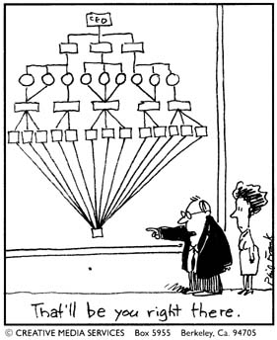
The Assistance Function
Major contributor to the IG workload
Complements Inspections and Investigations
Teaching and training

Slide 21
Inspector General Action Request
Assistance is the process of receiving, inquiring into, and responding to an Inspector General Action Request ...
  Complaints
  Request for Information
  Request for Assistance
... presented or referred to an IG.
IGAR
A&I Guide, Part One, Sect. 1-1

Slide 22
Who can Submit an IGAR?
ELO
1
Soldiers (Active, USAR, & ARNG)
Anonymous
Department of Army Civilians
Family Members
Retirees / Veterans
Commanders
Other Services
Government Agencies
Civilian-Civilians
Media
Contractors
Third Parties
Foreign Nationals
Referrals from:
  Other IGs
  Congress
  White House
Anyone
No precondition for coming to the IG
AR 20-1, para. 6-1
A&I Guide, Part One, Sect. 1-2

Slide 23
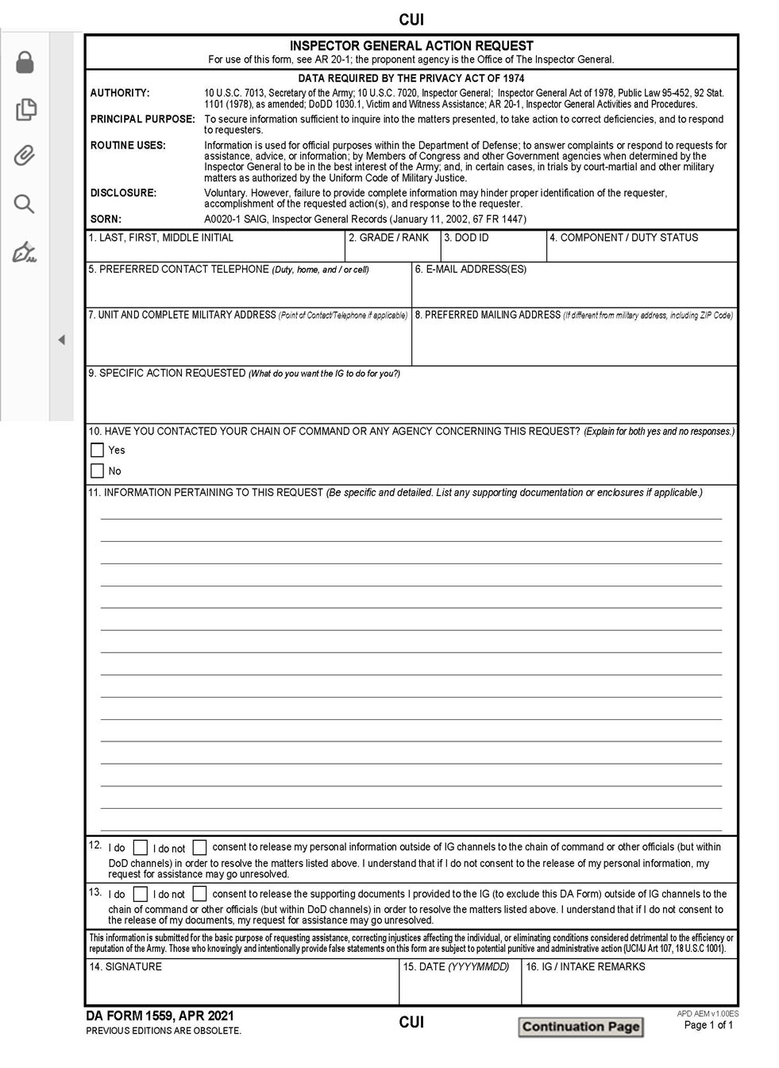
DA Form 1559
Inspector General Action Request
ELO
2
Privacy Act
Ability to attach files
What do you want the IG to do?
Turn & Tab
Consent Blocks
Signature and Date
IG (office) use only
Up to 10 continuation pages
A&I Guide, Part One, Sect. 1-3-1

Slide 24
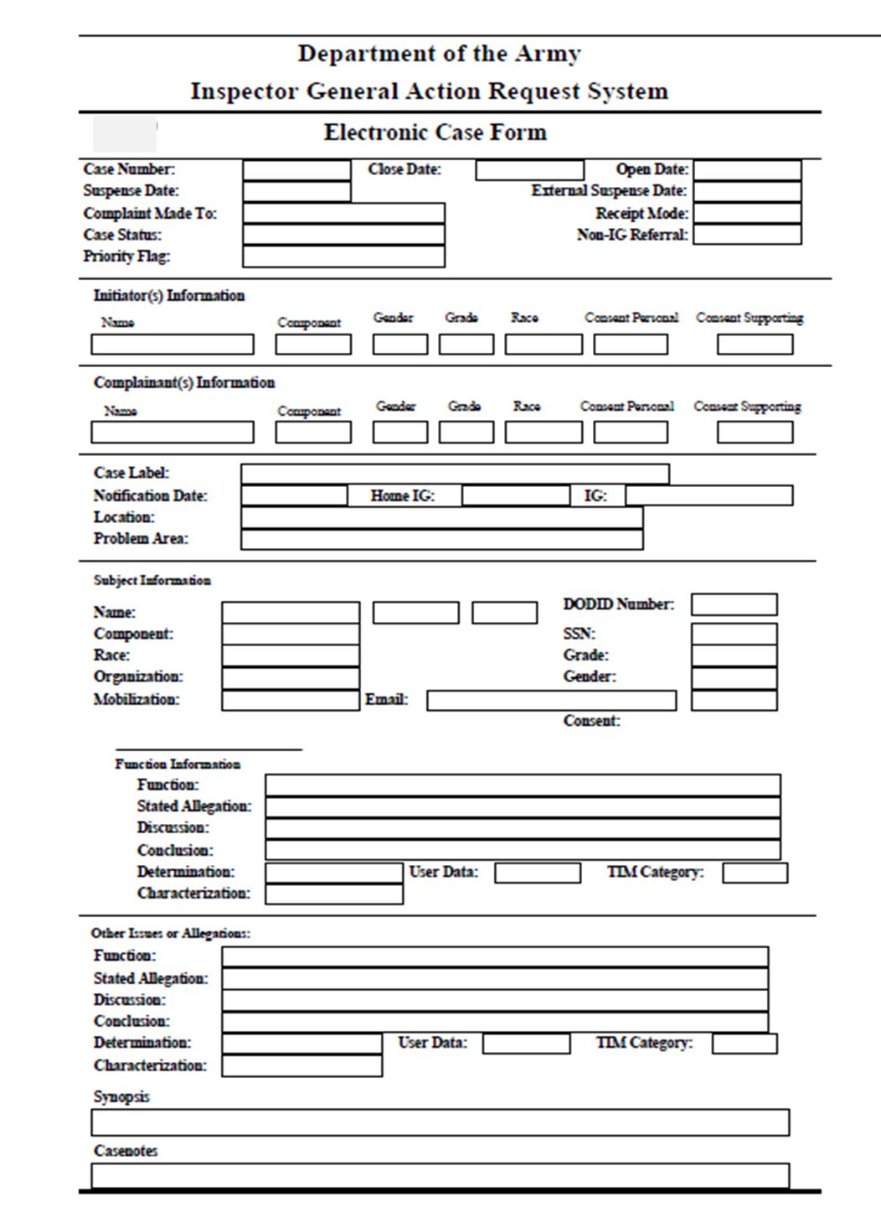
Electronic Case Form
(IGARS)
The IGARS Electronic Case Form
Do not give this
form to the complainant!
A&I Guide, Part One, Sect. 1-3-2

Slide 25
Check on Learning
Who may submit an IG complaint?
Anyone
What is the purpose of the DA Form 1559?
Privacy Act Notice
What can the IG do for you?
Complainant Consent
What is the use of the DA form 1559?
Primary Intake Tool
but Not Required

Slide 26

IG Confidentiality
ELO
4
Need not be specifically requested
NOT Guaranteed
Protects individual privacy and maintains confidence in the IG System
Ethically comparable to the doctor-patient relationship
AR 20-1, para. 1-13
A&I Guide, Part One, Sect. 2-2-1e

Slide 27
Triangle of Confidentiality
IGs
Degree of Protection
Individual Privacy Interest
**SJA**
Investigation /
Investigative Inquiry
Teach and Train
(less) Amount of Information Released by IG (more)
Directing Authority
Witness / Complainant
Assistance Inquiry
Commanders and Staff necessary to solve problem
Complainant
Commanders, Staff, and others who are part of the solution
Inspection Reports
Inspections information sources (Soldiers, commanders, units, etc.)
Protect privacy
Maintain confidence in the IG system
SJA not Trial Defense Service / Legal Assistance
Turn & Tab
AR 20-1, para. 1-13

Slide 28
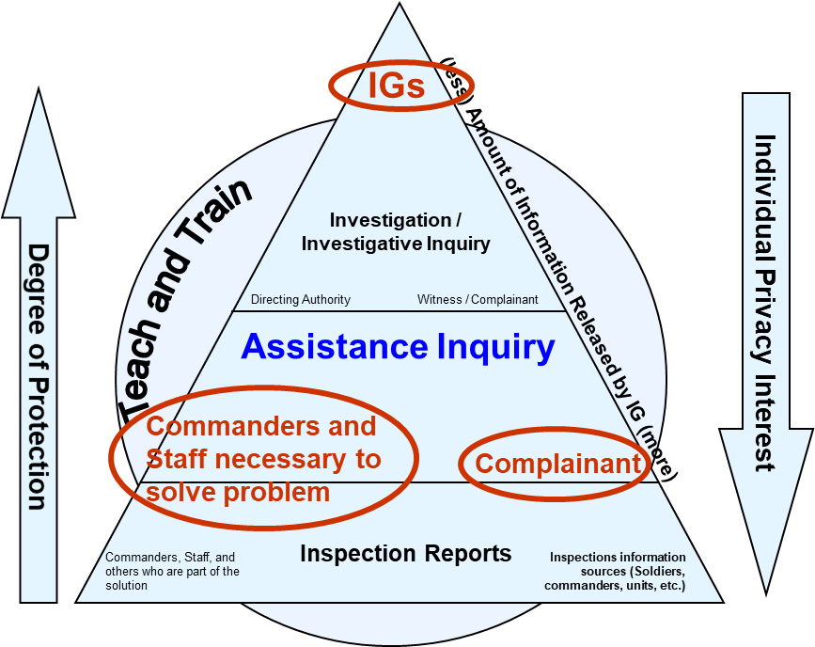
Triangle of Confidentiality
Clarification: AR 20-1, paragraph 1-7f (5) and 1-13
Directing Authority (DA) may bring staff members and subordinate commanders into the Triangle of Confidentiality (except for information pertaining to Investigations)
DA may authorize release by topic, function, timeframe, etc. (not limited to individual occurrences)
DA is not required to be present when authorized information is released
DA’s SJA always allowed in the Triangle of Confidentiality
at all levels
DA may release and / or authorize
the release of information about IG
Investigation(s) and allegations
to their CSM
**CSM**

Slide 29

Inspector General / CSM Relationship
  Meet regularly to discuss issues impacting the command
  Get CSM’s input for potential inspections
  Share Assistance trends and issues occurring within the command
  Share overarching observations
  Share Inspections reports, results, and recommendations (released by DA)
  Encourage the CSM to engage with the DA about IG matters
  Permissible release to resolve / action Assistance Case(s), as appropriate, while protecting confidentiality
  The CSM is allowed into the Triangle of Confidentiality when necessary and at the Directing Authority's discretion to include IG investigation and allegations.
AR 20-1, para. 1-7 f (5) and para. 3-3 b

Slide 30
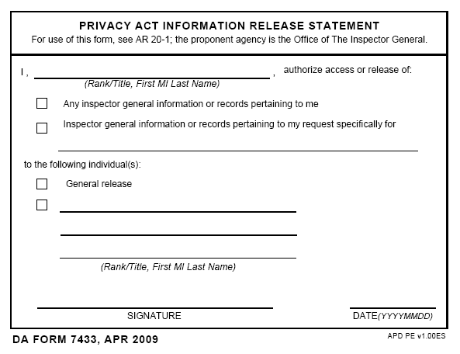
Third-Party IGARs
ELO
4
Response to third party depends on:
  Right to know
  Individual concerned (First Party) consents to release of information
A&I Guide, Part One, Sect. 2-2-6

Slide 31
Check on Learning
Describe the IG tenet of confidentiality and its primary purpose?
Does not have to be requested but cannot be guaranteed.
To protect individual privacy and maintain confidence in the IG system.
What do you need from a complainant to release their information in the course of IG work?
Consent (Blocks 12&13 on DA Form 1559)
… And for release of any information to a third party?
First party (injured party) signed DA Form 7433

Slide 32
IG Records
AR 20-1: Chapter 3
A&I Guide Part III

Slide 33
What is an IG Record?
Any written or recorded IG work-product
Includes:
  Correspondence
  Documents received from complainants in confidence
  IG reports
  Inspector General Network (IGNET) files
  IG requested documents not readily available
  IG notes and working papers
AR 20-1, para. 3-1

Slide 34
Nature of IG Records
All Army IG records are the property of Secretary of the Army, including
  USAR IG records
  ARNG IG records concerning Federal matters
IGs maintain records on SecArmy’s behalf
The Inspector General (TIG) is the designated release authority
AR 20-1, para 3-1
A&I Guide, Part Three, Section 1-1

Slide 35
Release of IG Records –
For Official Use Within
Dept. of the Army
ELO
11
Local IG may release:
TO:
Stipulation:
Inspection Reports Directing Authority Approval
ROI / ROII Directing Authority No adverse actions
Certain Records/ information:
*Nature of allegations
*Readily available documents
*Witness list with brief synopsis of their testimony
*Complainant-provided documents with release consent
Department of the Army Appointed Investigator
(AR 15-6 IO, FLIPL, etc.)
CID & MPI
Maintain impartiality;
Do not ID the complainant
Turn & Tab
AR20-1, para 3-1 (b), 3-2 (a), and para 3-4 (g)
A&I Guide, Part Three, Section 1-6

Slide 36
Release of IG Information Within Dept. of the Army
As a limited exception, information can be extracted from IG records to:
  Respond to requests for advice, assistance, or information
  Answer complaints
  Prepare closure letters
To the DA SJA IG for legal advice
IG Records may not be used for:
  Comparing commands or commanders
  Citing in evaluation reports, performance appraisals, award recommendations
AR20-1, para 3-3
A&I Guide, Part Three, Section 1-3

Slide 37
IG Records for
Adverse Action
ELO
12
IG records are not used as a basis for adverse action . . .
EXCEPT as approved by TIG …
on a by-exception basis
AR 20-1, para 3-5
A&I Guide, Part Three, Section 1-2

Slide 38
IG Records for
Adverse Action
Only the TIG can authorize the use of IG records for adverse action
IG office with the records submits request to: DAIG Records Release Office (SAIG-JAR)
  Identify precisely which records are requested and why
  Explain why a CMD investigation was not initiated & justify why follow-on investigation would be unduly burdensome, disruptive, or futile
Turn & Tab
Exception: DODIG approved WBR Investigations
AR 20-1, para 3-5
A&I Guide, Part Three, Section 1-2

Slide 39
IG Records
Release Authority
ELO
13
Only TIG can authorize release outside of IG channels
… Your CIG can’t do it
… Your CG can’t do it
… Your local FOIA office
can’t do it either
IG
Records
AR 20-1, para. 3-4

Slide 40
Release of IG Records Outside Dept. of the Army
Anyone may request copies of an IG record
  Member of Congress
  Other Government agencies
  Subpoenas and court orders…
Forward requests for IG records from other Federal Gov’t agencies to DAIG’s Records-Release Office (SAIG-JAR)
  Provide one copy of the requested information or IGARS case number… Call RRO first!
Reach out to DAIG Legal for assistance
A&I Guide, Part Three, Section 1-4

Slide 41
Requests From the Media
IGs neither confirm nor deny inquiries or investigations
Refer to local Public Affairs Office (PAO)
If specific records are requested, treat as FOIA
AR 20-1, para. 3-7b (3)

Slide 42
Freedom of Information Act (FOIA) Request
ELO
13
Request for records for unofficial purposes
Upon receipt of a verbal FOIA request:
  Direct requestors to the DAIG website: https://ig.army.mil/FOIA/
  OR
  Provide the contact information for DAIG Records
  Release Office (SAIG-JAR): usarmy.pentagon.hqda-otig.mbx.saig-zxl@army.mil
AR 20-1, para 3-7
A&I Guide, Part Three, Section 1-5

Slide 43
Freedom of Information Act (FOIA) Request
ELO
13
Upon receipt of a written FOIA request:
  Acknowledge receipt in writing
  Forward to DAIG Records Release Office:
    Original request (within 2 working days)
    Copy of the requested record(s) via encrypted e-mail, fax, mail (3-day delivery option)
    Memorandum documenting date of FOIA request (local concerns and other info.)
  Enter actions taken in IGARS as part of the case notes or as an Information IGAR
Turn & Tab
AR 20-1, para 3-7
A&I Guide, Part Three, Section 1-5

Slide 44
Release of IG Records
Summary
Official Use Local IG may release:
1) Inspection Reports (to Directing Authority)
2) ROI / ROII (to Directing Authority)
3) "BIG 3" (to Dept. of Army Investigator):
Nature of allegations, readily available documents, witness list with a synopsis of their testimony
Adverse Action Only TIG can approve
Outside Dept FOIA requests must be submitted to DAIG’s RRO
of the Army or in writing
for Unofficial Use
BEWARE of careless handling of IG documents (maintain control).
Don’t inadvertently give unauthorized information to complainants, witnesses, subjects/ suspects, other commanders or senior leaders (like COS) that are not your Directing Authority.

Slide 45


Storage of IG Records
Use of MS Teams (Army 365)
IGNET & IGARS are the only authorized places to store IG records
IG Records can be stored temporarily on local network
  IG staff section shared folder (NDA with IT Personnel)
Army MS Teams cleared up to CUI (includes PII)
  Create private ‘IG Members’ only
  Interview witness, complainant, subject / suspect but DO NOT record session using MS Teams - use external digital recorder
CAUTION: Use of external data programs and AI
Contact DAIG Legal to discuss release of IG Records: (703) 545-4591 and
Information Resource Management for records storage questions: (703) 614-2930
Notes:
It has come to our attention that there has been a report of a breach of IG records at an IG office. Although it was not the fault of the IG office, we need to ensure we are doing all we can to ensure our data is not compromised. AR 20-1, Chapter 3 defines the requirements to protect IG records, but we need to take extra steps to ensure we are not inadvertently giving access to non-IG personnel.
There have been many questions from the IG Enterprise concerning the storage of IG records and the use of MS Teams in conducting IG business, so here’s some guidance.
First and foremost, the only authorized storage of IG records is on IGNET, either on the IGNET network drives or in the IG-specific applications like IGARS. However, as you are working on cases or inspections, they can be temporarily stored on your local network drives and eventually moved to IGNET. Before storing them locally, ensure that your local IT support staff have set up a shared folder only accessible to your IG office personnel. They should create a security group for that folder that only has your IG office personnel in it. Naturally, the local network and system administrators will have access to this folder, as it required for the performance of their jobs to monitor the network and content, but they don’t routinely access any of these folders. You can ask those administrators to sign Non-Disclosure Agreements (NDAs), but you can’t force them to do so. The best practice is to temporarily store your IG documents on your local network drives and then move the finished product to your IGNET network drives.
Now that the Army has transitioned to full time use of MS Teams, many of you now can collaborate and share IG information, without the need to travel to the same location. The Army’s version of MS Teams is cleared to process data classified up to CUI, which includes PII. However, the sharing of that information is based on a need to know. IG offices should create “private” teams with only IGs as members to share the IG information. You can use the Meeting function to talk to a witness, complainant, or subject/suspect, but do not record the session on Teams. If you need to record the session, you should use a separate recording device such as a digital recorder and inform the individual that you are recording the session and they are not allowed to record the session. The key to the use of Teams is using “private” teams and not “public” teams that anyone can join.
If IG information must be released outside of IG channels, contact our Legal Division to request release. If you have any questions concerning the use of the local network drives or MS Teams, please contact the Information Resource Management Division led by Dr. Vernon Crocker.

Slide 46
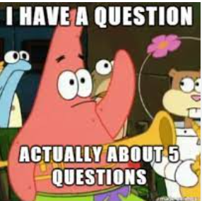
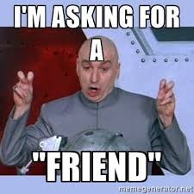




Always on the Record
Informal Requests for Information (RFIs)
“RANDOM” regulatory question or RFI =
SPECIFIC situation
No Blind Eye to Improprieties
  Social Media
  Military Acquaintances, Associates, Friends, and Family
  Inadvertent Awareness i.e., “Ear Hustling”

Slide 47

Keys to Success
Teach and Train - ALWAYS
Battle-Space Circulation – know leaders and be where the Soldiers are
Know other Inspectors General and exercise Tech Channels – across the installation and the force
Don’t lose credibility
  Maintain confidentiality
  Be Right before you move Forward
  Do the Work!
  Maintain Records
Humility – know yourself, your capabilities, and your level
Emotion vs. Insubordination – exercise emotional intelligence
Eliminate predisposed bias
Encourage Commanders and Staff to “Be the Hero”
Notes:
Too easy!!!!

Slide 48
Check on Learning
What records can the local IG release and to whom?
Inspection Reports to DA.
ROI/ROII to DA Only.
The “Big Three”:
Nature of allegations, Readily Available Documents,
and Witness list with brief synopsis of testimony
--To a Department of the Army Appointed Investigator Only.
Who is authorized to release IG records for adverse action and outside the Army?
TIG, and only TIG

Slide 49
Check on Learning
How do we process FOIA requests?
Verbal: Refer them to DAIG website (slide 44)
Written: (slide 45)
Acknowledge receipt in writing
Forward to DAIG RRO within 2 working days:
Original Request
Copy of Requested Records
Memorandum documenting request
Enter Actions into IGARS

Slide 50

The IG Assistance Function
Special Cases & Considerations
AR 20-1, Chapter 6
A&I Guide, Part One, Chapters 3 through 10

Slide 51
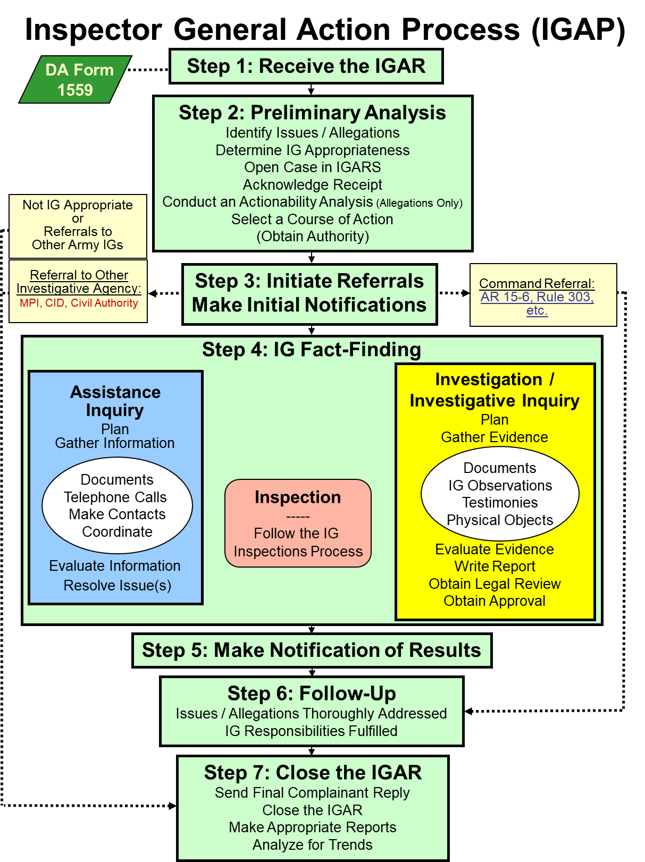
STEP 2 Determine IG Appropriateness
Step 2 Preliminary Analysis
Identify Issues / Allegations
Determine IG Appropriateness
Open Case in IGARS
Acknowledge Receipt
Conduct An Actionability Analysis (Allegations Only)
Select a Course of Action
(Obtain Authority)
Bottom Line:
Some complaints are not IG appropriate.

Slide 52

Not Local IG Appropriate Senior Official Allegations
ELO
6
Allegations against
  COL(P) and General Officer
  Senior Executive Service (SES) civilian
  Professor, USMA
Report to DAIG Investigations Div within 2 working days
Prior to an Information IGAR, contact Investigations Division: usarmy.pentagon.hqda-otig.mbx.saig-in-office@army.mil
Do not name the senior official
Do not complete a Standard IGAR or refer in IGARS
Do NOT conduct ANY fact-finding
Turn & Tab
AR 20-1, para. 7-1l, 1-4b (5) (d)
A&I Guide, Part One, Sect. 3-2-1

Slide 53

Not Local IG Appropriate
Professional Allegations
Army lawyers (military or civilian) contact DAIG’s Legal Advisor (AR 20-1, para. 7-1i (4)-(5))
IGs - refer to next higher IG (AR 20-1, para. 7-1j)
Medical, CID Agents, Recruiters, Chaplains (A&I Guide, Part I, Sect. 3-2-3)
A&I Guide, Part One, Sect. 3-2-3

Slide 54

Not Local IG Appropriate
Intelligence Activities
Allegations against
  Persons in a leadership position of a Special Access Program (SAP) or Sensitive Activity (SA)
Report to DAIG’s Intelligence Oversight Division(SAIG-IO) within 2 working days
AR 20-1, para. 1-4b (5) (e)
A&I Guide, Part One, Sect. 3-2-2

Slide 55
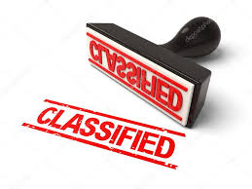
Intelligence Activities / Systems
IGARs Processing
Tech Channel: Unit Security Officer or DAIG- Intelligence Oversight Division for IGARs involving:
  Anything above Unclassified level
    Verbal
    Supporting Documentation
    Spillage
  Non-Intelligence Activities in classified system / area
  Security Clearances
  Questionable Intelligence Activities
    Report all QIAs within five days to SAIG-IO
    Route reports through the Commander per AR 381-10

Slide 56
Not IG Appropriate
ELO
5
Non-Army-related issues (A&I Guide, Part One, Sect. 3-1-1)
MEO complaints (with exception) (A&I Guide, Part One, Sect. 3-1-4)
Hazardous work conditions (A&I Guide, Part One, Sect. 3-1-7)
Redress available through other channels (A&I Guide, Part One, Sect. 3-1-2) (due-process review)
Criminal allegations (with exception) (A&I Guide, Part One, Sect. 3-1-6)
Soldier non-support of Family (A&I Guide, Part One, Sect. 3-1-3)
Redress available to DoD civilians (A&I Guide, Part One, Chapter 7)
Turn & Tab
AR 20-1, para. 6-3

Slide 57
Not IG Appropriate… But…
Family Non-support
Regulation: AR 608-99, Family Support, Child Custody, and Parentage
Commander’s Responsibilities (AR 608-99):
  Determine information necessary to resolve issue
  Respond to complainant within reasonable time
  ... and much more
IG’s Responsibilities (AR 20-1, para. 6-3a):
  Ensure Family’s immediate needs are met
  Ensure Soldier’s commander is aware
  Do NOT retain bank information
  Do NOT become an advocate
ELO
7
ELO
8

Slide 58
Family Non-support
Make Your Job Easier
Teach and train on AR 608-99
  Company Commander and First Sergeant Course
  Officer Professional Development / Noncommissioned Officer Development Program
  Newcomer’s Orientation
  Pre-deployment Training / Briefings
Available resources
  Family Readiness Groups (FRG)
  Army Community Services (ACS)
  Army Emergency Relief (AER)
  Chaplain
  DEERS / ID Card Station
  Red Cross
  Local Churches, Food Shelters
  http://www.militaryonesource.mil/

Slide 59
Not IG Appropriate
Private Indebtedness
Command issue (DODI 1344.09)
Know and adhere to state laws
IG’s role is to assist in properly routing the complaint
AR 20-1, para. 6-3b

Slide 60
Not IG Appropriate
Redress Available Through Other Means
Complainant must first comply with prescribed redress process
IG is limited to a review of the redress process to determine if the Soldier was afforded the due process provided by law or regulation
  Due-Process Review is IG appropriate … even if issue may not be IG appropriate or has another avenue of redress
  IG will attempt to resolve if determined Soldier was not given due process
Turn & Tab
Outcomes: Teach & Train
- There was no fault
- Complainant failed to comply
- Responsible official failed to comply
  AR 20-1, para. 6-1b. and 6-3g.
  A&I Guide, Part One, Section 4-1

Slide 61
Processing IGARs Not Appropriate for IGs
ELO
5
  Steps 1 and 2: Receive the IGAR, Open a Case in IGARS
  Thoroughly analyze the whole complaint to identify all issues / allegations
  Determine if the complainant has attempted to use the appropriate appeal process, if not, advise them to do so
  Provide information for the responsible office (contact / specific requirements)
  Warm Hand-off where appropriate
  Follow-up as required and Close the case in IGARS
  Look for possible systemic issues
AR 20-1, para. 6-3

Slide 62
Civilian IGARs Usually Not IG Appropriate
ELO
5
Grievances: Refer to Civilian Personnel Advisory Center (CPAC)
Appeals of Adverse Action: Refer to CPAC
Discrimination or Harassment Complaints: Refer to Equal Employment Opportunity (EEO)
Whistleblower Reprisal: Referral depends on status (more during investigations)
AR 20-1, para. 6-3h.
A&I Guide, Part One, Sections 6 & 7

Slide 63
Civilian IGARs which May Be IG Appropriate
Matters not directly affecting the employment situation or well-being of the individual:
  Third-party complaints
  Misconduct
  Mismanagement
AR 20-1, para. 6-3h
A&I Guide, Part One, Sect. 6-1

Slide 64
Civilian IGARs
Always analyze entire IGAR to determine if IG action is necessary to correct regulatory violation or systemic problem
Where does the IG go for advice?
  Local Civilian Personnel Advisory Center / Civilian Personnel Operations Center
  Staff Judge Advocate
  Equal Employment Opportunity
A&I Guide, Part One, Sect. 6-1

Slide 65
IG Decision Matrix for DoD Civilian Complaints
Receive IGAR and determine appropriateness
Yes
Process complaints or allegations against a third party, reports of misconduct, mismanagement, or matters requiring command attention
No
Grievance
Yes
Refer complainant to local CPAC for information and assistance
No
Appeal an adverse action
Yes
Enter in
IGARS
& Close Case
No
Advise to contact EEO- do not work this action
EEO
Yes
No
Yes
Yes
Retaliation or Reprisal
Whistleblower
Advise to contact OSC or DoD IG
No
Enter in IGARS take no further action
A&I Guide, Part One, Sect. 7-2

Slide 66
Check on Learning
What will an IG do with a complaint that is not IG appropriate?
Complete Steps 1 and 2 (Receive the IGAR and conduct Preliminary Analysis), then Refer to the appropriate agency via warm hand-off and Follow up as required
Name (four) topics that are not appropriate for the IG?
Hazardous Working Conditions;
Criminal Allegations;
Sexual Harassment and Assault Complaints;
When there is a means of Redress through other channels;
…

Slide 67
Check on Learning
What are the commander’s responsibilities in receiving and resolving non-support cases?
Determine information necessary to resolve the issue
Respond to the complainant within a reasonable amount of time
… And what are the IG’s responsibilities?
Ensure the family’s immediate needs are met
Ensure the Soldier’s commander is aware
How will the IG proceed when presented with an allegation against a senior official?
Receive the IGAR and … STOP! Call DAIG, then input an info IGAR.

Slide 68
Miscellaneous
Considerations

Slide 69


Request to Withdraw a Complaint
ELO
9
Ask Why:
  Fear of punishment or reprisal
  Someone else working the issue
  Issue is resolved
Obtain a written or verbal withdrawal request
IG decides whether or not to continue working the case
AR 20-1, para. 6-2e
A&I Guide, Part One, Sect. 4-2

Slide 70

Untimely IGARs
ELO
10
Timely Manner ~ Effective Resolution
An IGAR is “untimely" if:
  Date of awareness is more than one year ago
  “OR”
  The event occurred more than three years ago
AR 20-1, para. 6-1e
A&I Guide, Part One, Sect. 4-3

Slide 71
Untimely IGARs
(continued)
An untimely IGAR - event less than 3 years ago
Local IG will:
  Complete / Receive the DA Form 1559
  Identify all issues / allegations
  Open case in IGARS
  Decide whether or not to work
    Issue / allegation does not warrant further action
      Inform complainant that the IGAR is untimely
      Close case in IGARS
    Issue / allegation does warrant further action
      Continue with IGAP - work the case
AR 20-1, para. 6-1e
A&I Guide, Part One, Sect. 4-3

Slide 72
Untimely IGARs
(continued)
If the event occurred between 3-5 years ago and ...
  Extraordinary circumstances delayed complaint
  Special Army interest
IG will:
  Complete / Receive a DA Form 1559
  Identify all issues / allegations
  Open case in IGARS
  Forward for Army Command (ACOM), Army Service Component Command (ASCC), or Direct Reporting Unit (DRU) IG to decide whether or not to work it
  Inform complainant that the IGAR is untimely (case notes)
    Close case in IGARS
    OR – Work the case as approved / directed
AR 20-1, para. 6-1e
A&I Guide, Part One, Sect. 4-3

Slide 73
Untimely IGARs
(continued)
If the event occurred more than 5 years ago and ...
  Extraordinary circumstances delayed complaint
  Special Army interest
IG will:
  Complete a DA Form 1559
  Identify all issues / allegations
  Open case in IGARS
  Forward to TIG (SAIG-AC) to decide if IG will work the case or if other action is necessary
  Inform complainant that the IGAR is untimely (case notes)
    Close case in IGARS
    OR – Work the case as approved / directed
AR 20-1, para. 6-1e
A&I Guide, Part One, Sect. 4-3

Slide 74
Timeliness
Complaint
Timely
UNTIMELY
Knowledge > 1 year
Event > 3 years
Work Case
Don't Work
(IG decision)
Event < 3 yrs = Local IG
IG thinks
matter
warrants
addressing?
Event 3-5 yrs = ACOM, ASCC, DRU IG
Event > 5 yrs = TIG
Close Case

Slide 75
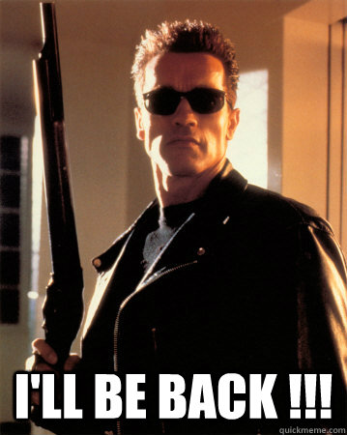
Habitual Complainants
“Pen / Phone Pals” “Super Email-er”
Analyze – Impartial, Unbiased, & Independent
  New, same information, or same case with new information
Always document in IGARS
Don’t ignore!
AR 20-1, para. 6-2b

Slide 76
Misusers of the IG System
Complainant’s responsibility to present truthful information
If documented history of:
  Submitting baseless, unfounded complaints
  Pattern of presenting false, malicious, deceptive, or defamatory complaints
THEN the Command IG -- with Directing Authority’s approval -- may request that all future correspondence be in writing
Approval Authority is TIG (through DAIG Assistance Division)
Turn & Tab
AR 20-1, para. 6-2f
A&I Guide, Part One, Sect. 4-5

Slide 77
Morale Assessments
Teach and Train directing authority on how to integrate morale assessments
Assessing morale is a key aspect of the IG charter and a critical barometer to help commanders determine their organization’s overall mission readiness
Morale vs. Command climate: Command Climate focuses primarily on leaders while morale focuses on the concerns of those being led
- IGs should be cautious engaging CC surveys since they must act on every issue/allegation that surfaces
Results (like trends) can be distributed on a CUI basis to subordinate commanders & staff as determined by the DA
  - Not used to compare leaders or commanders
Turn & Tab
A&I Guide, Part One, Chapter 5

Slide 78
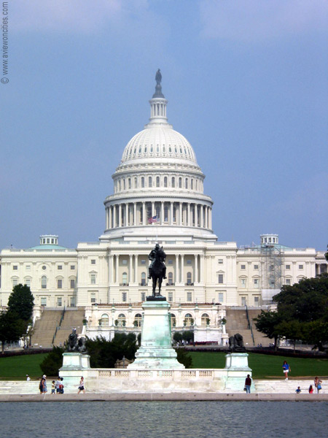
Congressionals
Just Another Way to Write-In

Slide 79
Congressional Correspondence Flowchart:
Command Channels
Complainant’s Letter to Member of Congress (MC)
MC Office
Office of the Chief of Legislative Liaison (OCLL)
Command Channels
Command Channels
Fort Von Steuben
Congressional Inquiries Office
A&I Guide, Part One, Sect. 8-1
79

Slide 80
Congressional Correspondence Flowchart:
IG Channels
Complainant’s Letter to Member of Congress (MC)
MC Office
Office of the Chief of Legislative Liaison (OCLL)
DAIG Assist Div
OoR
IG Channels
OoI
Fort Von Steuben
Inspector General Office
AR 20-1 para. 6-1f (1) and
A&I Guide, Part One, Sect. 8-2
OoI
80

Slide 81
Congressional Correspondence Flowchart:
National
Guard IG
(Federal Matters)
Complainant’s Letter to Member of Congress (MC)
MC Office
Office of the Chief of Legislative Liaison (OCLL)
DAIG Assist Div
OoR
NGB IG
OoI
State IG Office
AR 20-1 para. 6-1f (1) and
A&I Guide, Part One, Sect. 8-2
OoI
81

Slide 82
Congressional Correspondence Flowchart:
National
Guard IG
(State Matters)
Complainant’s Letter to Member of Congress (MC)
MC Office
State IG Office
AR 20-1 para. 6-1f (1) and
A&I Guide, Part One, Sect. 8-1
82

Slide 83
Coordination -- How to Prevent Duplication of Work
During a complainant’s interview (Step 1), the complainant tells the IG he or she wrote to their Member of Congress
DAIG’s Assistance Division refers a Congressional Inquiry to the local IG currently working or already completed and closed the case
Local IG actions:
  Coordinate / verify status of Congressional Inquiry with DAIG
  Inform complainant final response will come from their Member of Congress
AR 20-1 para. 6-1f (1) and
A&I Guide, Part One, Chapter 8

Slide 84
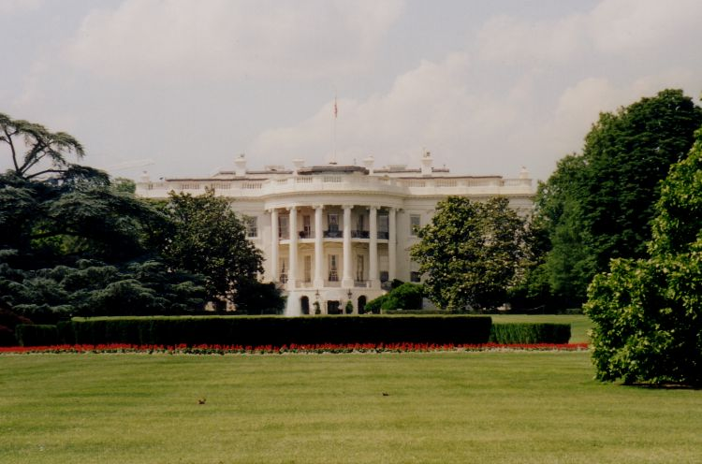
White House
(Presidential)
Yet Another Way Complainants Write-In

Slide 85
White House Correspondence Flowchart:
IG Channels
Complainant’s Letter to President (or email to www.whitehouse.gov)
White House Liaison Office
Complainant
DAIG Assist Div
OoR
IG Channels
OoI
Fort Von Steuben
IG Office
OoI
A&I Guide, Part One, Chapter 9
85

Slide 86


Department of Defense Hotline
DoDI 7050.01
AR 20-1, para. 6-1f (3), para. 7-3a
A&I Guide, Part One, Chapter 10

Slide 87
DoD Hotline
Case (Action) Flowchart:
IG Channels
Complainant contacts DoD Hotline
DoD Hotline
DAIG Assist Div
Complainant completes FOIA request through DoD IG for answer
OoR
IG Channels
OoI
Fort Von Steuben
IG Office
DoDI 7050.01
AR 20-1, para. 6-1f (3), para. 7-3a
A&I Guide, Part Two, Chapter 10
OoI
87

Slide 88
DoD Hotline
Case (Information) Flowchart:
IG Channels
Complainant contacts DoD Hotline
DoD Hotline
DAIG Assist Div
If Assistance Inquiry or Investigation results in "F" or "S", the Case converts to an Action Case. DAIG becomes OoR.
IG Channels
Fort Von Steuben
IG Office
DoDI 7050.01
AR 20-1, para. 6-1f (3), para. 7-3a
A&I Guide, Part One, Chapter 10
OoR
88

Slide 89
Check on Learning
What should an IG do when a complainant withdraws a complaint?
Ask WHY? And determine if to work it or not.
What constitutes an untimely IGAR?
Awareness of issue over one (1) year -OR- The event was over three (3) years ago
… and the procedures for processing an untimely IGAR?
Complete steps 1 and 2, inform the complainant that the IGAR is untimely, and the local CIG can determine if to work it if the event was less than three (3) years ago
By exception, if the event is 3-5 years old, the ACOM/ASCC/DRU CIG decides; over 5 years, TIG decides if to work it

Slide 90
Summary
Identified who may submit an Inspector General (IG) complaint.
Described the purpose and uses of the DA Form 1559, Inspector General Action Request (IGAR).
Described the seven-step Inspector General Action Process (IGAP) used to receive, process, and resolve IGARs.
Described the IG concept of confidentiality and the authorizations needed from the complainant to release that person's personal information for the purpose of resolving the individual’s issue or to inform a third party.

Slide 91
Summary
Identified issues and allegations that are not appropriate for the IG and describe how the IG must process those IGARs.
Described the actions an IG should take upon receiving an allegation against a senior official.
Described the commander’s role in receiving and resolving non-support cases in accordance with Army Regulation (AR) 608-99.
Described the IG’s role in receiving and resolving non-support cases in accordance with AR 20-1.
Described the actions an IG should take when a complainant withdraws a complaint.

Slide 92
Summary
Described what constitutes an untimely IGAR and the procedures for processing an untimely IGAR.
Identified what records a local IG may release, to whom, and for what purpose.
Identified who is authorized to release IG records for adverse action.
Identified who is authorized to release IG records outside of DA channels for non-official use and how to process a Freedom of Information Act (FOIA) request.

